Slide 1
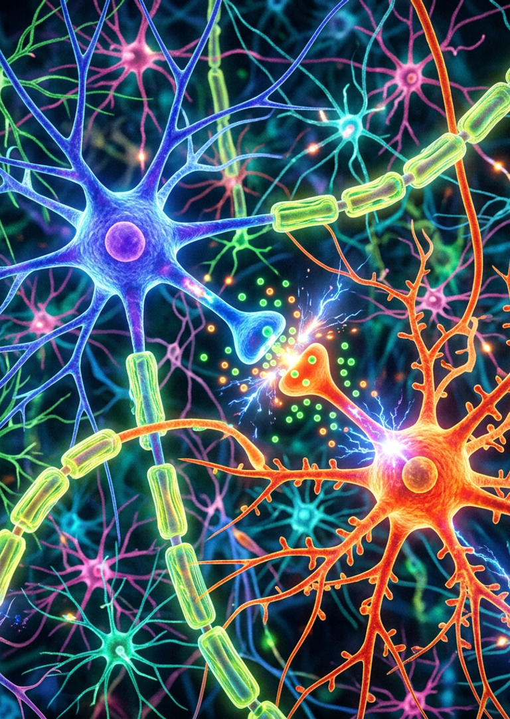

Transformer Model in PyTorch
From Theory to Code — a component-by-component walkthrough of the architecture that rewrote NLP.
Notes:
- Audience: CS students new to Transformers — assume basic PyTorch + linear algebra. - Arc: intuition first, then math, then PyTorch code — every block rebuilt from scratch. - Four chapters: Foundations → Building Blocks → Encoder/Decoder → Training. - Source deck: Arjun Sarkar / DataCamp, anchored to Vaswani et al. NeurIPS 2017.

Slide 2
CHAPTER ONE
01
Foundations
Why attention replaced recurrence — and what we are about to build, block by block, in PyTorch.
LIMITS OF RNNS
SELF-ATTENTION
THE 2017 PAPER
Sequential bottleneck, long-range decay.
Every token sees every other token directly.
Vaswani et al., “Attention Is All You Need”.
Transformer Model Tutorial · PyTorch · Chapter 1 of 4
Notes:
- This chapter sets up the “why” before the “how”. - Next slide walks through LSTM limitations and the parallelism case. - Then we preview the full encoder-decoder architecture at a glance.

Slide 3
MOTIVATION
Why Transformers Replaced LSTMs
LSTM VS TRANSFORMER
LSTM / GRU (pre-2017)
Before 2017, recurrent networks like LSTMs and GRUs were the default for sequence tasks — translation, summarization, speech. They worked, but they carried two structural debts: tokens had to be processed one at a time, and information had to survive a chain of hidden states. Transformers discard recurrence entirely. Every token attends directly to every other token, so context travels in O(1) hops and the whole sequence is processed in parallel on a GPU.
PROCESSING
Sequential (one token at a time)
PATH LENGTH
O(n) between distant tokens
GRADIENT
Vanishes over long chains
Transformer (2017–)
1
PARALLELISM
No recurrence means the whole batch processes at once. Training that took weeks now finishes in hours.
PROCESSING
Parallel across all positions
PATH LENGTH
O(1) between any two tokens
2
LONG-RANGE DEPENDENCY
CONTEXT
Global self-attention per layer
Attention links any two positions directly, so distant context is not washed out by gradient flow.
3
EXPRESSIVENESS
Multi-head attention lets the model attend to syntax, semantics, and coreference simultaneously, in different subspaces.
Slide 03 · Foundations
Transformer Model Tutorial
Notes:
- Parallelism is what unlocks GPU scale — weeks to hours. - Attention solves long-range decay that plagued LSTMs. - Multi-head attention gives multi-perspective context per layer. - This shift is what made BERT and GPT possible.

Slide 4
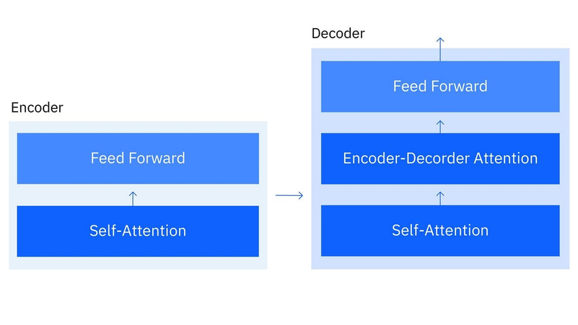
ARCHITECTURE OVERVIEW
The Transformer at a Glance
The model is an encoder-decoder stack. The encoder turns the source sequence into rich contextualized representations. The decoder generates the target sequence one token at a time, attending both to its own partial output (masked self-attention) and to the encoder output (cross-attention). Each side is a stack of N identical layers — six in the original paper.
1
EMBEDDINGS
2
POSITIONAL ENCODING
Token IDs → dense vectors of dimension d_model.
Adds sin/cos position signals to embeddings.
3
ENCODER STACK (NX)
4
DECODER STACK (NX)
Self-attention + feed-forward, wrapped in Add & Norm.
Masked self-attn + cross-attn + feed-forward.
5
LINEAR + SOFTMAX
Project decoder output to vocabulary probabilities.
Build plan — we will implement each block as a PyTorch nn.Module, then compose them into the full Transformer class.
Fig. — Encoder-decoder architecture (source: IBM)
Slide 04 · Foundations
Transformer Model Tutorial
Notes:
- Encoder = representation learner; decoder = autoregressive generator. - N = 6 layers in the original Vaswani et al. paper. - Every block we build in the next chapter plugs into this skeleton. - Cross-attention is the bridge between encoder output and decoder state.

Slide 5
CHAPTER TWO
02
Core Building Blocks
Three primitives — multi-head attention, position-wise feed-forward, and positional encoding — that every encoder and decoder layer is built from.
MULTI-HEAD ATTENTION
POSITION-WISE FFN
POSITIONAL ENCODING
Splits Q, K, V into h parallel heads.
Two linear layers with a ReLU between.
Sinusoidal signal injected into embeddings.
Transformer Model Tutorial · PyTorch · Chapter 2 of 4
Notes:
- This is the longest chapter of the deck. - Each primitive gets its own dedicated slide. - Math is introduced alongside PyTorch code so intuition and implementation arrive together.

Slide 6
class MultiHeadAttention(nn.Module) — __init__ + forward
BUILDING BLOCK · 01
Multi-Head Attention
class MultiHeadAttention(nn.Module):
def __init__(self, d_model, num_heads):
super().__init__()
assert d_model % num_heads == 0
self.d_model = d_model
self.num_heads = num_heads
self.d_k = d_model // num_heads
self.W_q = nn.Linear(d_model, d_model)
self.W_k = nn.Linear(d_model, d_model)
self.W_v = nn.Linear(d_model, d_model)
self.W_o = nn.Linear(d_model, d_model)
def forward(self, Q, K, V, mask=None):
Q = self.split_heads(self.W_q(Q))
K = self.split_heads(self.W_k(K))
V = self.split_heads(self.W_v(V))
attn = self.scaled_dot_product_attention(Q, K, V, mask)
return self.W_o(self.combine_heads(attn))
Parallel attention heads learn different relationship patterns.
1
LINEAR PROJECTIONS
— W_q, W_k, W_v project the input into three separate spaces: queries (what we want), keys (what we have), values (what we return).
2
HEAD SPLITTING
— d_model is split into num_heads chunks of size d_k = d_model / num_heads. Each head attends in its own subspace.
3
SCALED DOT-PRODUCT
— Per head: scores = QKᵀ / √d_k, softmax, multiply by V. (Math detailed on the next slide.)
4
CONCAT + OUTPUT
— Heads are concatenated back to d_model and passed through W_o — a learned linear mix of head outputs.
Why multiple heads? A single attention head must average over every relationship at once. Multiple heads let different heads specialize — one for syntactic dependencies, another for coreference, a third for topical similarity.
Slide 06 · Core Building Blocks
Notes:
- The only hard dimension constraint is assert d_model % num_heads == 0 — heads must divide the model width evenly. - W_o is the learned 'mixer' across heads — it decides how each head's output combines into the final vector. - d_k controls per-head capacity; smaller heads force specialization, more heads means thinner subspaces each. - The next slide unpacks the scaled dot-product math used inside every head.

Slide 7
THE CORE OPERATION
Scaled Dot-Product Attention
Attention(Q, K, V) = softmax( Q · Kᵀ / √d_k ) · V
— Vaswani et al., 2017, Eq. 1
scaled_dot_product_attention(self, Q, K, V, mask=None)
1
SIMILARITY (Q · Kᵀ)
def scaled_dot_product_attention(self, Q, K, V, mask=None):
# 1. Similarity: how much each Q matches each K
attn_scores = torch.matmul(Q, K.transpose(-2, -1)) / math.sqrt(self.d_k)
# 2. Masking: block forbidden positions (pad / future)
if mask is not None:
attn_scores = attn_scores.masked_fill(mask == 0, -1e9)
# 3. Normalization: turn scores into a probability distribution
attn_probs = torch.softmax(attn_scores, dim=-1)
# 4. Aggregation: weighted sum of values
output = torch.matmul(attn_probs, V)
return output
Dot product measures how aligned each query is with each key. Large positive = strong match; negative = unrelated.
2
SCALING (÷ √d_k)
Without scaling, dot products grow with d_k and push softmax into saturation where gradients vanish. √d_k keeps variance ~1.
3
MASKING (-1e9)
Setting masked logits to -1e9 forces their softmax weight to ~0, so the model cannot attend to padding or future tokens.
4
SOFTMAX + VALUES
Softmax converts logits to a probability distribution summing to 1. Multiplying by V returns a weighted blend of value vectors.
Slide 07 · Core Building Blocks
Notes:
- Stress that √d_k is the 'scaled' in scaled dot-product — it prevents softmax saturation. - Masking is what makes decoder self-attention causal by zeroing future-token logits. - Softmax is applied over the last dim — i.e. across keys, normalizing each query row. - This single function is reused for self-, cross-, and masked-attention with only the mask changing.

Slide 8
class PositionWiseFeedForward(nn.Module)
BUILDING BLOCK · 02
Position-Wise Feed-Forward Network
class PositionWiseFeedForward(nn.Module):
def __init__(self, d_model, d_ff):
super().__init__()
self.fc1 = nn.Linear(d_model, d_ff)
self.fc2 = nn.Linear(d_ff, d_model)
self.relu = nn.ReLU()
def forward(self, x):
# x: (batch, seq_len, d_model)
return self.fc2(self.relu(self.fc1(x)))
Two linear layers with a ReLU — applied identically to every position.
1
EXPAND-THEN-CONTRACT
— fc1 expands d_model → d_ff (typically 4× wider, e.g. 512 → 2048). fc2 projects back to d_model. The wider hidden layer is where non-linear feature mixing happens.
2
POSITION-WISE
— The same FFN weights are applied independently to each of the seq_len positions. No information flows between positions inside the FFN — that is attention's job.
3
WHY ReLU
— A linear stack of two layers collapses to one. ReLU between them introduces the non-linearity that lets the FFN learn arbitrary feature transformations.
DATA FLOW
[ d_model ]
[ d_ff ]
[ d_ff ]
[ d_model ]
The per-token "thinking" step. Attention decides what each token should see; the FFN then transforms what it sees into richer features for the next layer.
→
fc1
→
→
→
→
→
ReLU
fc2
Slide 08 · Core Building Blocks
Notes:
- d_ff is conventionally 4× d_model — the wider hidden layer is where feature mixing happens. - Position-wise means no cross-token mixing here; that role belongs entirely to attention. - ReLU is the original activation; modern variants use GELU or SwiGLU for slightly better gradients. - This is the second of three core building blocks (after multi-head attention, before positional encoding).

Slide 9
BUILDING BLOCK · 03
class PositionalEncoding(nn.Module)
Positional Encoding
class PositionalEncoding(nn.Module):
def __init__(self, d_model, max_seq_length):
super().__init__()
pe = torch.zeros(max_seq_length, d_model)
position = torch.arange(0, max_seq_length,
dtype=torch.float).unsqueeze(1)
div_term = torch.exp(
torch.arange(0, d_model, 2).float()
* -(math.log(10000.0) / d_model)
)
pe[:, 0::2] = torch.sin(position * div_term)
pe[:, 1::2] = torch.cos(position * div_term)
self.register_buffer('pe', pe.unsqueeze(0))
def forward(self, x):
# x: (batch, seq_len, d_model)
return x + self.pe[:, :x.size(1)]
Sinusoidal signals that tell the model where each token sits.
Self-attention is permutation-invariant — it sees a bag of tokens, not a sequence. To restore order, we add a position-dependent signal to each token embedding before any attention runs. The original paper uses sine and cosine of different frequencies, producing a unique smooth encoding for every position.
PE(pos, 2i) = sin( pos / 10000^(2i/d_model) )
PE(pos, 2i+1) = cos( pos / 10000^(2i/d_model) )
EVEN / ODD SPLIT
— Even indices of the d_model vector get sin; odd indices get cos. Different i values give different wavelengths.
SMOOTH & UNIQUE
— Each position has a unique encoding; nearby positions have similar encodings, so the model can learn relative offsets.
EXTRAPOLATES
— Unlike learned position embeddings, sinusoids generalize to sequences longer than those seen in training.
register_buffer → pe is part of module state but NOT a learnable parameter.
forward → slices pe to the actual seq_len of x, then adds element-wise.
Slide 09 · Core Building Blocks
Notes:
- div_term = exp(...) is the rewritten 1/10000^(2i/d_model) form for numerical stability. - register_buffer means pe moves with .to(device) automatically — no manual device juggling. - Slicing pe[:, :x.size(1)] handles variable-length inputs without re-allocating the table. - Sinusoidal vs learned is a design choice — BERT uses learned positional embeddings.

Slide 10
CHAPTER THREE
03
Encoder & Decoder
Stacking the building blocks into the two sides of the Transformer — one to read, one to generate.
/ 04
ENCODER LAYER
DECODER LAYER
STACKED ×N
self-attention + FFN, wrapped in Add & Norm
masked self-attn + cross-attn + FFN
six layers per side in the original paper
Transformer Model Tutorial · PyTorch · Chapter 3 of 4
Notes:
- Encoder and decoder share the same building blocks but compose them differently. - The decoder's cross-attention is the key innovation that lets it condition on the source sequence. - This chapter is the bridge between primitives and the full model.

Slide 11
CHAPTER 3 · ENCODER & DECODER
SLIDE 11
class EncoderLayer(nn.Module)
ENCODER · 1 OF 2 SUB-LAYERS PER LAYER
Encoder Layer
class EncoderLayer(nn.Module):
def __init__(self, d_model, num_heads, d_ff, dropout):
super().__init__()
self.self_attn = MultiHeadAttention(d_model, num_heads)
self.feed_forward = PositionWiseFeedForward(d_model, d_ff)
self.norm1 = nn.LayerNorm(d_model)
self.norm2 = nn.LayerNorm(d_model)
self.dropout = nn.Dropout(dropout)
def forward(self, x, mask):
# Sub-layer 1: self-attention + Add & Norm
attn = self.self_attn(x, x, x, mask)
x = self.norm1(x + self.dropout(attn))
# Sub-layer 2: feed-forward + Add & Norm
ff = self.feed_forward(x)
x = self.norm2(x + self.dropout(ff))
return x
Self-attention and a feed-forward network, each followed by Add & Norm.
1
INPUT
x enters the encoder layer (shape: batch × seq × d_model).
2
SELF-ATTENTION
MultiHeadAttention(x, x, x) — every token attends to every other.
3
ADD & NORM
x + dropout(attn_output), then LayerNorm. The residual preserves the original signal.
4
FEED-FORWARD
PositionWiseFeedForward transforms each position independently.
5
ADD & NORM
Same pattern: residual + dropout + LayerNorm. Output goes to the next layer.
WHY ADD & NORM?
Residual connections (Add) let gradients flow straight through deep stacks, mitigating vanishing gradients. LayerNorm (Norm) normalizes each token's features to zero mean and unit variance, stabilizing training and allowing higher learning rates.
SLIDE 11 · ENCODER & DECODER
TRANSFORMER MODEL TUTORIAL · PYTORCH
Notes:
- Every encoder layer has the SAME structure; only the learned weights differ between layers. - The original paper stacks Nx=6 of these layers — depth is what gives the model capacity. - Residual + LayerNorm is the pattern that lets you stack deep without gradients vanishing. - Dropout is applied to the sub-layer output BEFORE the residual add — not after.

Slide 12
CHAPTER 3 · ENCODER & DECODER
SLIDE 12
class DecoderLayer(nn.Module)
DECODER · 3 SUB-LAYERS PER LAYER
Decoder Layer
class DecoderLayer(nn.Module):
def __init__(self, d_model, num_heads, d_ff, dropout):
super().__init__()
self.self_attn = MultiHeadAttention(d_model, num_heads)
self.cross_attn = MultiHeadAttention(d_model, num_heads)
self.feed_forward = PositionWiseFeedForward(d_model, d_ff)
self.norm1 = nn.LayerNorm(d_model)
self.norm2 = nn.LayerNorm(d_model)
self.norm3 = nn.LayerNorm(d_model)
self.dropout = nn.Dropout(dropout)
def forward(self, x, enc_output, src_mask, tgt_mask):
# 1. Masked self-attention over target tokens
attn = self.self_attn(x, x, x, tgt_mask)
x = self.norm1(x + self.dropout(attn))
# 2. Cross-attention: queries from x, keys/values from encoder
attn = self.cross_attn(x, enc_output, enc_output, src_mask)
x = self.norm2(x + self.dropout(attn))
# 3. Feed-forward
ff = self.feed_forward(x)
x = self.norm3(x + self.dropout(ff))
return x
Masked self-attention, cross-attention, and a feed-forward — each wrapped in Add & Norm.
1
MASKED SELF-ATTENTION
uses tgt_mask
The decoder attends to its own partial output so far. tgt_mask blocks future positions so the model cannot cheat during training.
2
CROSS-ATTENTION
uses src_mask
Queries come from the decoder (x); keys and values come from the encoder output. This is how the decoder conditions on the source sequence.
3
FEED-FORWARD
no mask
Same position-wise FFN as the encoder. Transforms the cross-attended features before passing to the next decoder layer.
tgt_mask
src_mask
Padding mask AND look-ahead (no-peak) mask combined. Position i can only attend to positions ≤ i.
Padding mask only. Hides <PAD> tokens in the source sequence so the encoder output for those positions is ignored.
SLIDE 12 · ENCODER & DECODER
TRANSFORMER MODEL TUTORIAL · PYTORCH
Notes:
- Decoder has 3 LayerNorms (one per sub-layer) vs encoder's 2. - Cross-attention is the only place where encoder and decoder interact. - The no-peak mask is what makes generation autoregressive — position i cannot see position i+1. - Source and target masks are passed separately because they have different shapes.

Slide 13
PART 04 OF 04
SECTION HEADER
CHAPTER FOUR
04
Assembly &
Training
04
Compose the full Transformer, configure hyperparameters, run the training loop, and evaluate.
/ 04
FULL TRANSFORMER
HYPERPARAMETERS
TRAINING
embeddings + enc stack + dec stack + linear
d_model=512, num_heads=8, num_layers=6, d_ff=2048
CrossEntropyLoss + Adam, 100 epochs, eval with torch.no_grad
TRANSFORMER MODEL TUTORIAL · PYTORCH · CHAPTER 4 OF 4
SECTION HEADER
Notes:
- This is the payoff chapter where everything plugs together. - Masking is the trickiest implementation detail — set expectations. - The training loop here is intentionally minimal; real projects add LR scheduling, label smoothing, and beam search.

Slide 14
CHAPTER 4 · ASSEMBLY & TRAINING
SLIDE 14
class Transformer(nn.Module) — __init__ + generate_mask + forward
FULL MODEL · MASKING DEEP DIVE
class Transformer(nn.Module):
def __init__(self, src_vocab_size, tgt_vocab_size,
d_model, num_heads, num_layers, d_ff,
max_seq_length, dropout):
super().__init__()
self.encoder_embedding = nn.Embedding(src_vocab_size, d_model)
self.decoder_embedding = nn.Embedding(tgt_vocab_size, d_model)
self.positional_encoding = PositionalEncoding(d_model, max_seq_length)
self.encoder_layers = nn.ModuleList(
[EncoderLayer(d_model, num_heads, d_ff, dropout)
for _ in range(num_layers)])
self.decoder_layers = nn.ModuleList(
[DecoderLayer(d_model, num_heads, d_ff, dropout)
for _ in range(num_layers)])
self.fc = nn.Linear(d_model, tgt_vocab_size)
self.dropout = nn.Dropout(dropout)
def generate_mask(self, src, tgt):
src_mask = (src != 0).unsqueeze(1).unsqueeze(2)
tgt_mask = (tgt != 0).unsqueeze(1).unsqueeze(3)
seq_length = tgt.size(1)
nopeak_mask = (1 - torch.triu(
torch.ones(1, seq_length, seq_length),
diagonal=1)).bool()
tgt_mask = tgt_mask & nopeak_mask
return src_mask, tgt_mask
def forward(self, src, tgt):
src_mask, tgt_mask = self.generate_mask(src, tgt)
src_emb = self.dropout(self.positional_encoding(
self.encoder_embedding(src)))
tgt_emb = self.dropout(self.positional_encoding(
self.decoder_embedding(tgt)))
enc_out = src_emb
for layer in self.encoder_layers:
enc_out = layer(enc_out, src_mask)
dec_out = tgt_emb
for layer in self.decoder_layers:
dec_out = layer(dec_out, enc_out, src_mask, tgt_mask)
return self.fc(dec_out)
Assembling the Full Transformer
FORWARD PASS · 4 STEPS
1
EMBED + ENCODE
src/tgt → embedding → +positional encoding → dropout.
2
ENCODER STACK
Pass src through N encoder layers; keep enc_out.
3
DECODER STACK
Pass tgt through N decoder layers, each attending to enc_out.
4
PROJECT
Linear layer maps decoder output to tgt_vocab_size logits.
MASKING — THE FIDDLY BIT
•
src_mask = (src != 0)
Boolean padding mask: True where the source token is not <PAD>. Shape (batch, 1, 1, seq_len).
•
tgt_mask = padding AND nopeak
Combined mask: True only where the target token is not <PAD> AND the query position is ≤ the key position (no looking ahead). torch.triu with diagonal=1 builds the upper-triangular no-peak mask.
SLIDE 14 · ASSEMBLY & TRAINING
TRANSFORMER MODEL TUTORIAL · PYTORCH
Notes:
- nn.ModuleList registers layers so their parameters are tracked by the optimizer. - The unsqueeze pattern aligns mask shape with attention scores (batch, num_heads, seq, seq). - torch.triu(diagonal=1) zeros the diagonal and below — keeps only the lower triangle. - Masks are recomputed every forward because seq_len can vary per batch.

Slide 15
SAMPLE CONFIGURATION
HYPERPARAMETER IMPACT
PARAMETER | RANGE | TRADE-OFF
d_model | 256, 512, 1024 | Higher = more capacity, more compute
num_heads | 8, 12, 16 | More heads = diverse patterns, costlier
num_layers | 6, 12, 24 | Deeper = more representation power
dropout | 0.1, 0.3 | Regularization vs underfitting
learning rate | 1e-4 to 1e-3 | Convergence speed vs stability
5000
512
8
6
SRC/TGT VOCAB SIZE
D_MODEL (EMBEDDING DIM)
NUM_HEADS
NUM_LAYERS (ENC + DEC)
2048
100
0.1
64
D_FF (FFN INNER DIM)
MAX_SEQ_LENGTH
DROPOUT
BATCH SIZE
Training loop
TRAINING · KEY DETAILS
criterion = nn.CrossEntropyLoss(ignore_index=0)
optimizer = optim.Adam(transformer.parameters(),
lr=0.0001, betas=(0.9, 0.98), eps=1e-9)
transformer.train()
for epoch in range(100):
optimizer.zero_grad()
output = transformer(src_data, tgt_data[:, :-1])
loss = criterion(
output.contiguous().view(-1, tgt_vocab_size),
tgt_data[:, 1:].contiguous().view(-1))
loss.backward()
optimizer.step()
print(f"Epoch {epoch+1}, Loss: {loss.item():.4f}")
1
SHIFTED TARGETS
Input is tgt[:, :-1] (drop last token). Loss is computed against tgt[:, 1:] (drop first token). This teaches the model to predict the next token.
2
CROSS-ENTROPY
ignore_index=0 skips <PAD> tokens in the loss. Standard for sequence tasks where batches are padded.
3
ADAM
Original paper used Adam with lr=1e-4, betas=(0.9, 0.98), eps=1e-9, plus a warmup schedule. We use the same fixed lr here for simplicity.
EVALUATION
transformer.eval() + torch.no_grad()
transformer.eval()
with torch.no_grad():
val_output = transformer(val_src_data, val_tgt_data[:, :-1])
val_loss = criterion(val_output.view(-1, tgt_vocab_size),
val_tgt_data[:, 1:].view(-1))
print(f"Validation Loss: {val_loss.item():.4f}")
.eval()
Switches off dropout and batch-norm updates. Required for deterministic inference.
torch.no_grad()
Disables autograd, reducing memory and speeding up forward passes during validation.
SLIDE 15 · ASSEMBLY & TRAINING
TRANSFORMER MODEL TUTORIAL · PYTORCH
Notes:
- 100 epochs is illustrative — random data won't show real learning. - betas=(0.9, 0.98) is the original Vaswani et al. paper setting. - Label smoothing and LR warmup are common additions in real training pipelines. - val_loss on random data tells you the model runs but not that it learned. - In production swap random data for a real parallel corpus (e.g. WMT).

Slide 16
END OF DECK
CONCLUSION
What You've Built
WHY THIS MATTERS
This 2017 architecture is the foundation of BERT, GPT, T5, and every modern large language model. The encoder-only variant powers classification and embedding; the decoder-only variant powers generation; the full encoder-decoder powers translation and summarization. Master this skeleton and the rest of modern NLP is a variation on it.
A complete Transformer — encoder, decoder, attention, masking, training — from scratch, in pure PyTorch.
✓
ARCHITECTURE
You implemented multi-head attention, position-wise FFN, and sinusoidal positional encoding as standalone nn.Modules.
FAQ TEASER
✓
ENCODER & DECODER
Why are Transformers more efficient than LSTMs for handling long sequences?
You composed them into encoder layers (2 sub-layers) and decoder layers (3 sub-layers), each wrapped in Add & Norm.
✓
FULL MODEL
Two reasons. (1) Self-attention links any two positions in O(1) steps, while LSTMs need O(n) recurrent steps. (2) The whole sequence processes in parallel on a GPU — no recurrence to serialize over.
You assembled embeddings, positional encoding, Nx stacks, and a linear head into one Transformer class.
✓
MASKING
You built src_mask (padding) and tgt_mask (padding + no-peak) — the subtle detail that makes generation causal.
✓
TRAINING
FURTHER READING
You wired CrossEntropyLoss + Adam and ran a 100-epoch training loop plus an evaluation pass with torch.no_grad.
Vaswani et al. (2017) · DataCamp tutorial (Arjun Sarkar, Apr 2025) · Hugging Face Transformers · The Annotated Transformer (Harvard NLP)
SLIDE 16 OF 16 · END OF DECK · THANK YOU
TRANSFORMER MODEL TUTORIAL · PYTORCH
Notes:
- The building blocks are reusable beyond seq2seq — ViT uses them for images, audio models for spectrograms. - Suggest "The Annotated Transformer" (Harvard NLP) as a complementary line-by-line read. - Encourage students to swap random data for a real MT dataset (WMT14, IWSLT) next. - This exact skeleton scales to GPT-3-class models with more layers, more data, more compute.

